Slide 1
Annual Meeting American Association of University Centers on Excellence in Developmental Disabilities
Stephanie Giordano
Valerie Bradley
Alexandra Bonardi
Human Services Research Institute
Washington, DC
November 7, 2017

Slide 2
Project Tools and Overview
National Core Indicators

Slide 3
What is NCI?
NCI is a voluntary effort by public developmental disabilities agencies to measure and track their own performance.
Collaboration began in 1997
Currently 46 states and Washington D.C. represented plus 22 sub-state entities
Coordinated by HSRI and NASDDDS

Slide 4
NCI Tools
Family Surveys
Staff Stability
Adult In-person Survey*
*Formerly Adult Consumer Survey

Slide 5
Significance
Statistical significance means that the outcome is not due to chance
NCI typically looks at significance to:
Compare statewide average to the NCI average
Compare outcomes within groups (e.g., compare community participation outcomes for people who are fully mobile v those who are not)
Is statistical significance always important?
Outcomes shown in the presentation are denoted with one asterisk (*) if significant at .01
Notes:
Discussion on how to use significance to guide policy/initiatives; when a significantly higher outcome may still mean there is room for improvement (e.g., ANE)

Slide 6
Adult In-Person Survey
Standardized, face-to-face interview with a sample of individuals receiving services
Background Information - includes health information
Section I (no proxies allowed)
Section II (proxies allowed)
No pre-screening procedures
Conducted with adults only (18 and over) receiving at least one service in addition to case management
Section I and Section II together take 50 minutes (on average)

Slide 7
NCI Sample 2015-16
36 states conducted the ACS
Total of 17,682 valid surveys completed
Key Demographics
Average age: 43
Gender: 58% male to 42% female
Level of ID:
38% mild
30% moderate
13% severe
10% profound
9% unspecified

Slide 8
Decision-Making
NCI measures choice and autonomy, inclusion in service planning, and self-determination
What do NCI data tell us?

Slide 9
Choice and Decision-Making

Slide 10
Choices

Slide 11
Staff and Case Manager
Chose or Can Request to Change
70% Staff
71% Case Manager

Slide 12
Who Makes Choices?
Several demographics showed significant differences between groups in making decisions, including:
Preferred means of expression
Level of ID
Mental health diagnosis or behavioral challenge
Diagnosis of:
Autism Spectrum Disorder
Cerebral Palsy
Seizure Disorder
Mobility
Limited or No Vision
Residence
Support needed for behavioral challenges
Guardianship

Slide 13
Choice and Residence

Slide 14
Behavioral Support Need
Chose Home*
64% no support needed
50% support needed
Chose Roommates*
55% no support needed
Decides Daily Schedule*
86% no support needed
Chooses What to Buy*
89% no support needed
Decides How to Spend Free Time
93% no support needed
40% support needed
82% support needed
92% support needed
87% support needed

Slide 15
Guardianship

Slide 16
Impact of Choice on Satisfaction
People who chose their home were more satisfied with where they lived
People chose their staff or know they could request a staff change reported staff showed them respect, came and left on time, and training to meet their needs
People who chose their case manager or know they could request a change were more positive about their case manager and were more involved in service planning.

Slide 17
Relationship Between Choice and Satisfaction with Home and Community Participation
Able to Go Out and Do Things in the Community S/He Likes*
86%
chose home
79%
Did not choose home
Able to Go Out and Do Things in the Community Enough*
76%
chose home
72%
Did not choose home
Has Enough to Do at Home*
83%
chose home
77%
Did not choose home

Slide 18
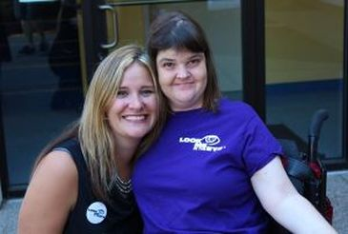
Chose Staff and Staff Outcomes
Staff Are Respectful*
94% chose staff
Staff Show Up and Leave On Time*
94% chose staff
89% did not choose staff
Staff Have Right Training to Meet Needs*
92% chose staff
87% did not choose staff
89% did not choose staff

Slide 20
Relationship Between Choice of Case Manager and Service Planning
Nearly everyone attended the last service planning meeting regardless of case management choice
Significantly higher proportions of those who chose their case manager (or were aware they could request a change, compared to those who did not make the choice):
Knew what was being talked about at the last planning meeting 85% v 80%
Reported the planning meeting included people the person wanted there 94% v 90%
Chose services as part of their service plan 80% v 71%

Slide 21
Service Planning

Slide 22
99%
took part in the last planning meeting, or chose not to
93% planning meeting included the people person wanted
88% knew what was being talked about at the last planning meeting
77% chose services they get as part of their service plan

Slide 23
Connecting Goals With What Person Wants
20% have a paid community job
45%
Want a paid community job
40% wants a job and has employment as a goal in service plan

Slide 24
Self-Determination

Slide 25
What Is Self-Determination?
People plan their own lives, make their own decisions, determine how resources are spent for their supports, plan & choose their own supports (formal and informal), and take responsibility for the decisions made.
Freedom
Authority
Supports
Responsibility

Slide 26
It is About Changing Systems...
Shifting authority for decision making to the individual.
Changing the way supports are funded to give people direct control over dollars.
Changing the role of service providers, case managers and support staff.
Putting the person into the center of the relationship between the state and provider organization.

Slide 27
Antecedents Include...
Early family support programs
Personal assistance programs
Employment voucher innovations (Ticket to Work)
Cash and counseling (1996-2013) programs
Robert Wood Johnson Foundation demonstration

Slide 28
Self-Determination
10% of people surveyed used a self-directed supports option

Slide 29
Variance by State

Slide 30
Demographic Profile of People Who Self-direct
Average Age
35
Gender
56% male
44% female
Race*
73% White
12% Black/African American
15% Other

Slide 31
Level of ID
Mild
Moderate
Severe
30%
31%
14%
8%
Profound
Unspecified
18%

Slide 32
Who Makes Decisions About How the Budget is Used?

Slide 33
Using Self-directed Supports

Slide 34
Self-advocacy Supporting people to make their voices heard

Slide 36
Participated in a Self Advocacy Group, Meeting, Conference or Event
22% Participated
5% Chose Not To
73% Did Not Participate
Notes:
Specific to disability advocacy

Slide 37
Demographics
Age*
Gender
26% male
28% female
Race*
28% White
24% Black/African American
25% Other
18-22
23-34
35-54
55-74
75 and older
25%
20%
29%
27%
29%

Slide 38
Communication and Self Advocacy
27% of people whose primary language was English participated in a self-advocacy event compared to 14% whose primary language was not English*

Slide 39
Diagnoses and Self Advocacy
Level of ID*
31% mild
27% moderate
21% severe
18% profound
25% unspecified

Slide 40
Relationships

Slide 41
Going Out in the Past Month
Shopping*
93% Participated
90% Did not
Errands*
91% Participated
87% Did not
Entertainment*
81% Participated
76% Did not
Dining*
92% Participated
86% Did not
Religious or Spiritual Practice*
54% Participated
45% Did not
Community Group*
51% Participated
33% Did not

Slide 42
Vote

Slide 43
Health Exams

Slide 44
What do NCI Data Tell Us About Dental Care?

Slide 45
When Was the Last Dental Exam?

Slide 46
Personal Characteristics
Gender
81% Male
82% Female
Race*
77% Black/African American
83% White
77% Other

Slide 47
Residence
Proportion of People Who Had a Dental Exam in the Past Year in Each Residence Type*
Institutional Setting
Group Residential Setting
Own Home or Apartment
94%
Family Home
88%
79%
75%
Residential Designation
82% Metropolitan
82% Micropolitan
81% Rural
81% Small Town

Slide 48
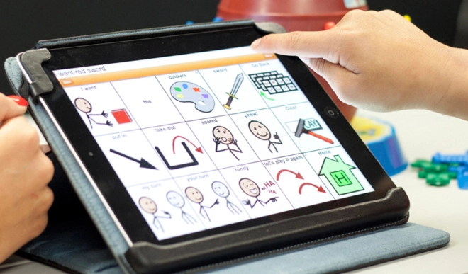
Communication
Primary Language
81% English
Preferred Means of Communication*
82% Spoken
77% Other
78% Gestures
85% Sign Language or Finger Spelling
82% Communication Aid or Device
78% Other -Overall, 79% of those who are non-verbal had a dental exam in the past year

Slide 49
Dental Exam in the Past Year by Level of ID
81% of those with ID and 80% without had a dental exam in the past year
Notes:
Whether the person had an ID diagnosis was not statistically significant

Slide 50
Mental Health and Behavioral Challenges
How Behavioral Challenges Impact Having Dental Exam
80% of those who had a behavioral challenge compared to
84% of those who did not have a behavioral challenge *
80% of those need support for a behavioral challenge compared to
82% of those who did not need support for a behavioral challenge*
Notes:
Other mental illness is significant at .05

Slide 51
Dental Exam in the Past Year by Diagnoses

Slide 52
Wellness
Uses Tobacco Products*
82% do not use tobacco product
76% do use tobacco product
Exercises Regularly*
77% exercise regularly
72% do not exercise regularly

Slide 53
Healthcare
Had a Physical Exam in the Past Year*
81% of those with a primary care doctor v. 79% without had a dental exam in the past year*

Slide 54
Dental Care Recap
Certain demographics showed significant difference between those who had a dental exam in the past year including,
Type of residence
Level of ID show significant differences
A diagnosis of CP or Down Syndrome
Means of communication
Those who had a dental exam also tended to have better wellness and positive healthcare outcomes

