Slide 1

The OSU Nisonger Center (UCEDD) NCI Adult in-person Survey
Presented by Annamarie Sigman, Ohio NCI Coordinator & Marc J. Tassé, PI

Slide 2

Nci Nisonger history
Nisonger Center just finished the third NCI survey cycle for the Ohio Department of Developmental Disabilities(DODD), this is the 11th year the state of Ohio has participated
Our team at the Nisonger Center collects the data for DODD
Our team responsibilities include:
  Hiring and training of NCI interviewers
  Interviewing 700 randomly selected individuals
  Interviewing up to 100 individuals who moved out of developmental centers

Slide 3

Logistics: Scheduling
Scheduling tip sheet versus script
Encourage interviewers to make their own script to sound more natural
Scheduling assistance provided

Slide 4
Completed Survey
ODESA Background complete feature for BI
Detailed spreadsheet for completed in-person survey

Slide 5
NCI Ohio badge
Interviewers in Ohio needed another form of identification when entering some homes, group homes, and facilities

Slide 6
Interviewer Porter
Password Protected
RESOURCES!
Interviewer forms such as invoice, mileage, vendor, etc.
Training materials
Printable Survey
http://nisonger.osu.edu/adult/adult-clinics-services/national-core-indicators-project/

Slide 7

Payment to interviewers
OSU interviewers are non-employees at OSU and are recognized as vendors/independent contractors
Interviewers are paid per interview at a rate of $45
Interviewers are paid mileage if they travel minimum 60 miles roundtrip

Slide 8

Who makes up our interviewer team?
People with disabilities
Family members of people with disabilities (Parents/Sibs mostly)
IDD Professionals

Slide 9
Meet our Interviewers Page
http://nisonger.osu.edu/adult/adult-clinics-services/national-core-indicators-project/meet-our-interviewers/

Slide 10

Training
Webinar- option for people unable to travel to the OSU
In-person- preferred
HSRI & NASDDDS slides and then Nisonger protocol
Shadow interviews for additional training

Slide 11
Shadow interview
Nisonger team does the majority of Shadow interviews, Our more experienced interviewers shadow as well
Our team uses a shadow interview guide, some examples of our questions are: Was the interviewer prepared for the interview? Was the interviewer able to reword and rephrase questions without changing the intent of the original question? And were your answers to the survey the same as the interviewer you shadowed?

Slide 12
Communication: Monthly Newsletter

Slide 13
Working with People with disabilities
Observations:
Most likely to use a co-interviewer
Less interviews
Lack of Transportation
Additional training needed
Hard to find PwD interested
Benefits:
Experience- they know the language
Acquire new Job skills
Learn more about disability issues
Empower other PwD fby leading by example

Slide 14

NCI Interviewers Share Benefits of Job
https://www.youtube.com/watch?v=YNXTeQbrXZA&feature=youtu.be

Slide 15
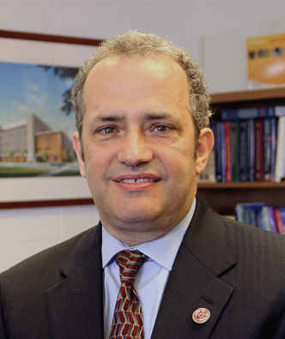
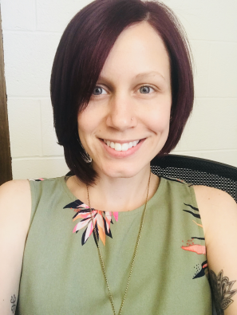
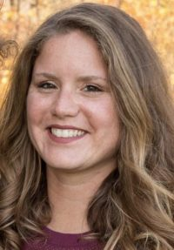
Nisonger Team
Marc J. Tassé, NCI PI, Director of Nisonger Center-UCEDD
Marc.Tasse@osumc.edu
Annamarie Sigman, NCI Coordinator, Annamarie.Sigman@osumc.edu 614-685-3195
Emily Ebert, Program Assistant, Emily.Ebert2@osumc.edu
Please visit the Nisonger NCI webpage at Nisonger.edu.osu/NCI

