Slide 1
National Core Indicators
State of Utah
Department of Human Services
Division of Services for People with Disabilities

Slide 2
How does Utah use NCI Data?
Workgroup: Group identified four areas of improvement based on the Adult Consumer Survey Report. Benchmarks were created and initial brainstorming began.
Areas included:
Employment
Choice in living setting
Health and safety in home/work/day program environments
Health: Annual physical exams
Legislative Reporting:
Funding requests to serve people on the waiting list
Direct support staff wage increases (Staff Stability Survey)
Legislative performance measures

Slide 3
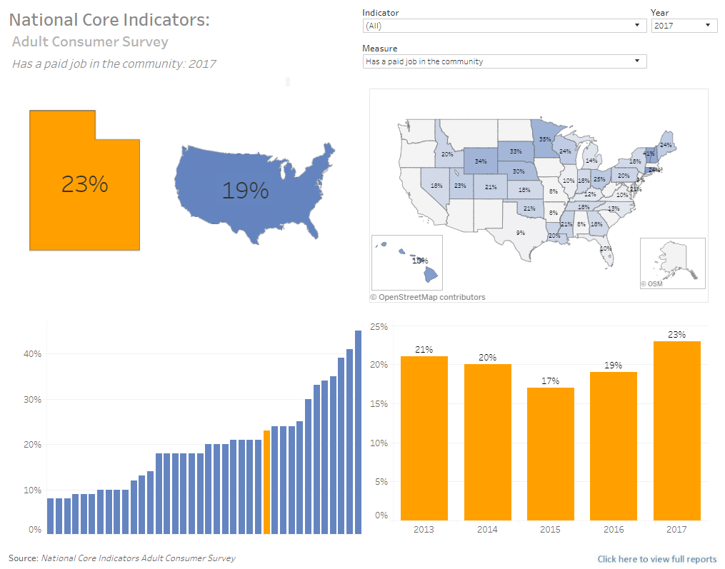
NCI Dashboard
Link: https://dspd.utah.gov/dashboard/national-core-indicators/

Slide 4
Feedback
The dashboard was shared with Division staff, stakeholders, families, contracted providers, and the Division’s advisory council. Feedback was requested in areas of functionality, strengths and weaknesses of the dashboard, value, and clarity.
Strengths of Dashboard:
Visual comparison between Utah and other states (Map)
Comparison between Utah and Nation
Colors, Utah is easily identified. Nice visualization when looking at all the states
Weaknesses of Dashboard:
Difficult to understand for people not familiar with NCI
Doesn’t answer questions for people unfamiliar with how data was collected
“How do you collect responses from someone who is non-verbal”
“How do you validate the data”
Switching measures that are under a different indicator renders a “Data Unavailable” warning
Data
Not all states participate each year
Just data, no analytics

Slide 5
Feedback
Value of Dashboard:
Stakeholders/Legislators can see where Utah ranks with other states
Division staff can use in a variety of reports, particularly those including state case studies
Gives support to families and stakeholders when discussing areas of concern with the Division
Quality assurance staff can use this information in contact reviews with providers
Uses: (Not included above)
Visualizations for presentations to stakeholders and legislators
Policy writing

Slide 6
Future Considerations
Print or Save image option. The dashboard is designed to be interactive but having these options is also a good idea
Include family surveys
Include a citation if printing or saving image. Also include a link to the full citation
Using a measure as a filter (Only an option for Utah because of the granularity of the data needed)
Secondary dashboard looking at both the primary and secondary measure
Link to NCI website to answer questions about NCI or a link to a document that explains the survey, data collection, validating the data, etc.
Another dashboard that has measures that Utah is significantly above or significantly below the NCI average

Slide 7
Questions?
Email: cmidgley@utah.gov
Dashboard: https://dspd.utah.gov/dashboard/national-core-indicators/

