Slide 1
Sharing National Core Indicators Results with Wisconsin’s Long Term Care Advisory Council
Angela Witt
Integrated Data & Analytics Section Chief
August 1, 2018

Slide 2
Sharing Results With the Advisory Council
Wisconsin Long Term Care Advisory Council (LTCAC) history
Current LTCAC charge
Quality strategy
National Core Indicators (NCI) results
Use in quality strategy
Presentation to LTCAC
LTCAC feedback

Slide 3
LTCAC History
2008–2012 | Wisconsin Council on Long Term Care
2012 | Name changes to Long Term Care Advisory Council
2008–2015 | Advises the Department of Health Services (DHS) on implementation of Family Care (managed long-term services and supports program)
2016 | Council charges change

Slide 4
Current LTCAC Charges
Charge | Description
Quality | Explore the development and use of quality metrics to analyze the long-term care system and service outcomes
Workforce | Develop strategies and data metrics to address workforce shortages in the long-term care system
Notes:
Quality charge is really where NCI results come in
Have also had Mary Lou present to LTCAC about provider survey – potentially relevant to workforce charge although we have not conducted that survey in WI

Slide 5
Current LTCAC Charges, continued
Charge | Description
Community development | Develop strategies to keep people safe and healthy in the community and prevent the need for long-term care services
Communications | Develop plans to communicate to all long-term care stakeholders

Slide 6
Quality Strategy for People in Long-Term Care
Whole Person
Statewide Measures
Medicaid Long-Term Care
Medicaid Programs
Quality
Medicaid Contractors
Medicaid Providers
Notes:
As a part of the LTCAC quality charge, DHS has presented on LTC quality strategy goals and potential indicators and sought LTCAC feedback.

Slide 7
Division of Medicaid Services Long-Term Care Values and Goals
#1: Promote efficient and cost-effective services and supports through innovation, standards, data-driven quality, and evidence-based practices.
#2: Focus on the whole person, including their physical, psychosocial, and spiritual needs to live and work freely in their home and community.

Slide 8
Values and Goals, continued
#3: Empower people with access to an array of services and supports.
#4: Ensure continuous improvement of high-quality programs to achieve people's identified goals and outcomes.

Slide 9
Values and Goals, continued
#5: Engage people to have meaningful choices about where and with whom they live, their services, and who provides them.
#6: Empower consumers to make informed choices.

Slide 10
Using NCI to Measure Goals
Goal: Focus on the whole person, including their physical, psychosocial, and spiritual needs to live and work freely in their home and community.
NCI questions that help measurement of goal:
Are you able to go out and do the things you like to do?
Are you as active in your community as you’d like to be?
Notes:
(NCI In Person Survey)
(NCI-AD)

Slide 11
Presenting NCI Results to LTCAC
Background on NCI survey(s)
Populations included
Content
Sample sizes
NCI results
Compared to national averages
Compared to prior year
Seek feedback on where to focus and how to use in quality strategy

Slide 12
Example of Results Presentation: Community Inclusion Slide
Two measures are now in average range that were below average in 2015–16.
People able to go out and do the things they like to do:
86% matches NCI average
Up from 78% in 2015–16
Community inclusion scale score:
Now within average range at 82%
Change was NCI average rather than WI results

Slide 13
Example of Results Presentation: Community Inclusion Slide
Still below average on people going out and doing things they like as often as they would like.
2016–17: 67% Wisconsin vs 78% NCI average
Somewhat higher than the 63% Wisconsin 2015–16 result

Slide 14
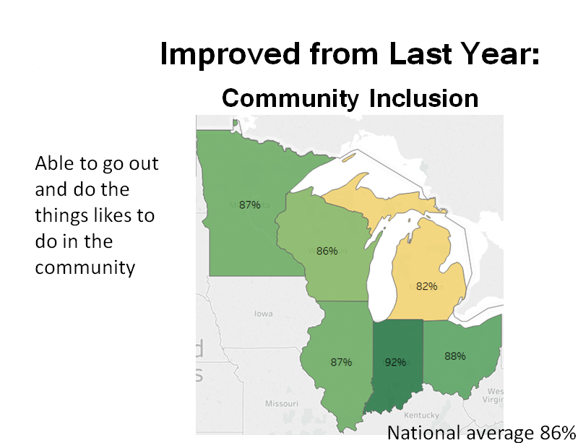
Community Inclusion Results Example, continued

Slide 15
Example of Discussion Questions
Which indicators are the most important or informative?
Which indicators are the highest priorities for improvement?
What are the barriers to improving on those indicators, and how could those barriers be addressed?
Notes:
We do often have more discussion of what the results are, what they mean, and what the council thinks is important – and then don’t necessarily get to in depth discussion of #3.

Slide 16
LTCAC Discussion of NCI Results
Often focused on a few important topics
Employment
Transportation
Interest in more details
Program—we can do that
Managed care organization—maybe someday
Adding NCI Aging and Disabilities survey!
Not much feedback on how to address barriers to improvement
Notes:
Employment discussion often includes questions about definitions, and how NCI results compare to other information. We try to focus on what NCI adds – comparison to other states, and things we don’t have in other data sources – versus whether the % employed is the same as another data source with a larger population and/or different definition.
After we clarify definitions and answer questions on what additional data and breakouts we will and won’t have and when, we don’t necessarily get to that third discussion question

Slide 17
LTCAC Feedback on Using NCI in the Quality Strategy
Prior feedback on quality strategy: Measure if services are member centered and flexible enough to meet the needs of the member.
Additional NCI questions identified:
Whether services and supports help people live a good life
Member-centered planning questions about taking part in service planning and making decisions

Slide 18
LTCAC Feedback on State-Specific Questions in the NCI
2017–18 Wisconsin questions
Asked LTCAC about important topics
Added “why not” questions to follow up on barriers to transportation and employment
2018–19 Wisconsin questions
Review 2017–18 questions used.
Ask about any additional topics.
Are possible additions more important than 2017–18 questions?
Notes:
After discussion at LTCAC, decided that consistency was a priority for 2018-19 and we’ll keep the same Wisconsin questions

