Slide 1


Outcomes For Adults On The Autism Spectrum Receiving Services In 31 States:
Putting The Research In Context
Valerie J. Bradley
Human Services Research Institute
vbradley@hsri.org
Ari Ne’eman
Autistic Self Advocacy Network
aneeman@autisticadvocacy.org

Slide 2
Terminology Preferences
Within the autism and Autistic communities, a wide variety of different linguistic preferences exist, with many individuals on the autism spectrum preferring the use of “identity-first” language rather than “person-first”.
Within this presentation, we will alternate between “person on the autism spectrum” and “autistic person”.
See http://autisticadvocacy.org/home/about-asan/identity-first-language/ for more details.

Slide 3
Overview
Background
  Autism in the USA
    Prevalence/Characteristics
    Services and Supports
    Differential outcomes
  What is National Core Indicators?
What do NCI data show about outcomes for autistic adults?
Policy Recommendations
Discussion

Slide 4
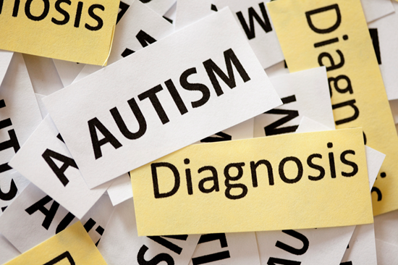
What Do We Know About People with Autism?

Slide 5

Autism Spectrum Disorder
Prevalence estimates of ASD are rising
  Autistic people represent higher percentage of population than previously recognized.
Proportion of Autistic people with co-occurring intellectual disabilities (ID), by some estimate, is as high as 60%
  However, some question the applicability of standardized tests for people with ASD.

Slide 6

Autism and State I/DD
Service Systems
In some states, Autistic people are eligible for ID/DD services.
  Often due to concomitant ID diagnosis, functional limitations, and/or state eligibility criteria that goes beyond ID
  Recently, some states adopting “autism waivers.”
However, the number of individuals enrolled is small.
  Hewitt et al. (2012) estimated that only 8.1% of the individuals receiving public I/DD services have been assigned an ASD diagnosis.

Slide 7

Autism and State I/DD Service Systems
DSM-5 eliminated the separate categories of autism disorder including pervasive developmental disorder, Asperger's syndrome, childhood disintegrative disorder and autistic disorder. Instead there will be one diagnostic category for the autism spectrum.
To be classified on the spectrum, individuals must show deficits in social communication impairment, and restricted interests/repetitive behaviors
These changes may result in increased access to services for those who may have met the functional eligibility criteria for waiver services but have been excluded because of
their presenting diagnosis

Slide 8

Sweeping Changes Over Past Several Decades
Developmental Disabilities Assistance and Bill of Rights Act
Americans with Disabilities Act (ADA)
Individuals with Disabilities Education Act (IDEA)
Rehabilitation Act of 1973......
Led to growth of community-based settings for people with disabilities
  Goal: aim to encourage “full inclusion and integration in the economic, political, social,
  cultural and educational
  mainstream of American society”

Slide 9
Autistic Individuals Lag Behind
Autistic people do not appear to have benefited to the same extent as those without autism. Research has shown:
  Poorer adult life outcomes in areas such as:
    Independent living
    Community inclusion
  Teens with ASD fared worse than other students with intellectual disabilities.
    physical well-being, social support and psychological well-being

Slide 10
What do NCI data show regarding outcomes for Autistic adults receiving public services?
National Core Indicators

Slide 11
What is NATIONAL CORE INDICATORS (NCI)?
NASDDDS, HSRI & State DD Directors
  Multi-state collaboration
  Launched in 1997 in 13 participating states – now in 45 states (including DC) and 22 sub-state areas
Goal: Measure performance of public systems for people with intellectual and developmental disabilities by looking at outcomes
  Help state DD systems assess performance by benchmarking, comparing to other states
  Domains: employment, community inclusion, choice, rights, health, safety, relationships, service satisfaction etc.

Slide 12
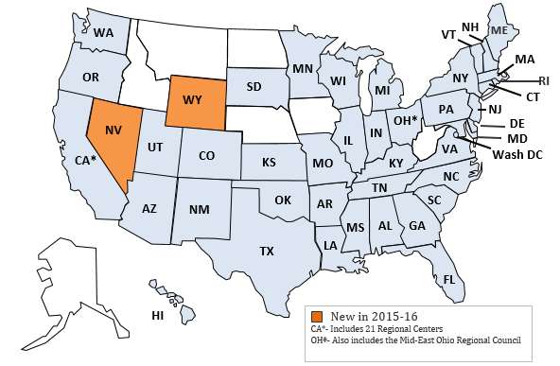
NCI State Participation 2015-16

Slide 13

Data Source: Adult Consumer Survey
Standardized, face-to-face interview with a sample of individuals receiving services
  Background Information - includes health information
  Section I (no proxies allowed)
  Section II (proxies allowed)
No pre-screening procedures
Conducted with adults only (18 and over) receiving
at least one service in addition to case management
Section I and Section II together take 50 minutes
(on average)

Slide 14
Data for This Presentation
NCI Consumer Survey Data, 2013-14
  30 states, DC, and 1 sub-state entity
  15,525 individual surveys
Subsample identified:
  Diagnosis of “Autism Spectrum Disorder (i.e., Autism, Asperger Syndrome, Pervasive Developmental Disorder)” identified in background
  Information on diagnoses taken from agency records
  The total number of records indicating the presence of ASD was 2,277

Slide 15

What do NCI data show about Autistic adults receiving state I/DD services?
National Core Indicators

Slide 16

Demographics
25%
of those who reported ASD Diagnosis are female
p<=.001

Slide 17
Demographics: Age and Residence
Average age of respondents with ASD Diagnosis: 33.5
Average age of respondents without ASD Diagnosis: 44.9

Slide 18
More Individuals with Autism Have a Mental Health Diagnoses
49% of those with ASD have behavior challenges
***p ≤.001
Autistic individuals were far more likely to be reported as receiving medications for anxiety, mood, behavior or psychotic disorders: ASD Diagnosis: 72% No ASD Diagnosis: 52%

Slide 19
More Individuals with Autism Have Guardians
Guardianship status of Adult Consumer Survey respondents by ASD diagnosis
***p≤.001
National Core Indicators (NCI)

Slide 20


People with Autism Less
Likely to Live in Their
Own Home/Apartment
22% of those with no ASD diagnosis live in their own home or apartment. 10% of those with an ASD diagnosis live in their own home or apartment

Slide 21
Fewer People With ASD Use Words to Speak
30% of those with ASD diagnosis communicate primarily using gestures/body language

Slide 22
Autistic Adults Are Less Likely to be Employed
*p ≤.05
***p ≤.001

Slide 23
Autistic Adults Are Less Likely to Make Choices About Their Lives
***p≤.001
Of those with ASD Diagnosis: using a self directed supports option: 14%
Of those with No ASD Diagnosis: using a self directed supports option: 8%

Slide 24

Autistics Adults
Less Likely to
Have Friends
***p≤.001
National Core Indicators (NCI)

Slide 25
Autistics Adults Less
Likely to Have Friends
***p≤.001
National Core Indicators (NCI)

Slide 26

What are the Policy Initiatives that Will Enhance Outcomes for Autistic Adults?

Slide 27
Key Policy Issues
Research
Long Term Services and Supports
Housing
Employment
Legal Autonomy and Supported Decisionmaking

Slide 28
Research
Significant disparities in autism research funding allocation
In 2010, of NIH’s $217M in Autism Research, only 1.5% went towards adults and only 2.45% towards services research
Need for Participatory Action Research models

Slide 29
Long Term Services and Supports
CMS HCBS Settings Rule
Significant Gap for Autistic people who do not meet institutional LoC
Emerging use of state 1915i state plan authority to meet need for this population
Family Support

Slide 30
Housing
Settings rule encouraging a shift towards supported living, shared living models;
States need to establish rental subsidy programs to make supported living viable;
Congregate models frequently replicate the dynamics of an institution;

Slide 31
Employment
Five states (VT, MA, OR, RI, NY) have or are committing to phasing out sheltered work;
Growing Olmstead litigation around integrated employment;
Integrated Day Services often key to the employment discussion;
S. 1604, the Transition to Independence Act

Slide 32
Legal Autonomy and SDM
Article 12 of the UN CRPD
Texas recently became first state to adopt SDM Law;
ASAN Model Legislation on Healthcare Supported Decision-Making
Liability issues remain to be sorted out, especially in financial and healthcare SDM

Slide 33

What did they
say?

